Slide 1


Commission on Criminal Justice and Sentencing Reform:
System-wide Criminal Justice Spending
June 3, 2015

Slide 2
Executive summary
The Budget and Capacity Committee is focused on helping the Commission understand the balance between county and state funding of the criminal justice system; and realign and reinvest tax dollars to achieve and sustain a 25 percent reduction of the prison population.
To better understand the flow of criminal justice funding on the state and local levels, the Civic Consulting Alliance and the Illinois Sentencing Policy Advisory Council examined the 12th Judicial Circuit (Will County) as a test case.
1
Overview of project and future plans
2
Funding sources and expenditures in Will County
3
Highlights of system costs in Will County
4
Next steps
<number> / 10

Slide 3
1
High-level work plan
Highly dependent on access to and availability of reliable data
Phase I:
Define and test approach
Phase II:
Scale up
Timing
May 18th – June 3rd
Post June 3rd
Main activity
Collect data for Will County (FY 2014)
Collect data from additional counties (FY 2014)
Flow chart
Overview of local and state costs
Diversify geographically
Calculate reasonable cost estimates
Compare resource allocation to prison use
Deliverables
<number> / 10

Slide 4
1
Today we will focus on two budget questions
Phase I:
Define and test approach
How does funding flow through the criminal justice system?
2. How will reducing the prison population affect local budgets?
May 18th – June 3rd
Collected data for Will County (FY 2014)
Flow chart
Overview of local and state costs
<number> / 10

Slide 5


2
Will County relies on multiple funding sources
State Funding
Police
Jail
Court
Prison
Supervision
Expenditures in Will County criminal justice system $219.2 M
Source: Data from Will County Auditor’s database, 2015 - http://www.willcountyauditor.com/#!annual-expense-analysis/cngi
Note: See appendix section A for full breakdown of categories
<number> / 10

Slide 6
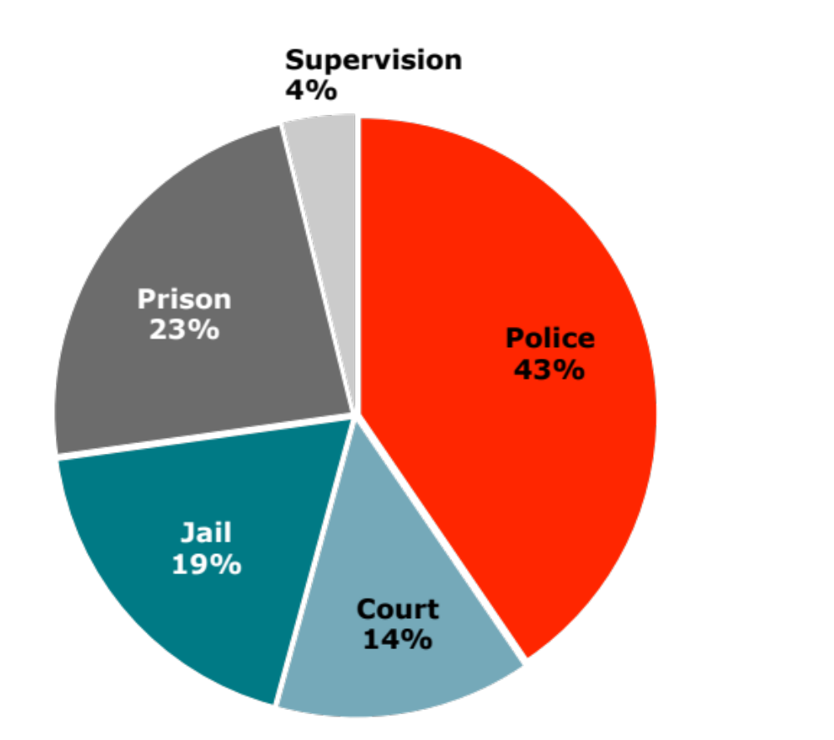
2
Will County’s criminal justice expenditures
FY 2014 Expenditures = $ 219.2 million
Police are the largest portion of criminal justice expenditures
The County Sheriff’s Office comprises a significant portion of the police costs
Probation is the majority of supervision spending
Source: Data from Will County Auditor’s database, 2015 - http://www.willcountyauditor.com/#!annual-expense-analysis/cngi
Note: See appendix section A for full breakdown of categories and methodology
<number> / 10

Slide 7
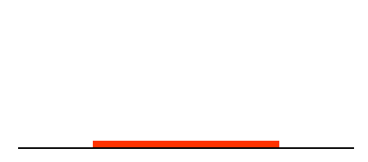
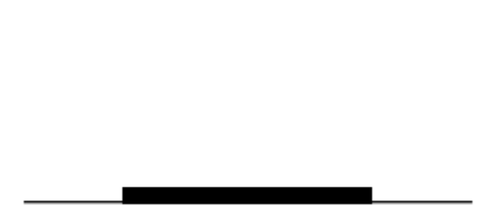
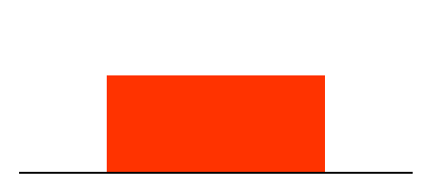
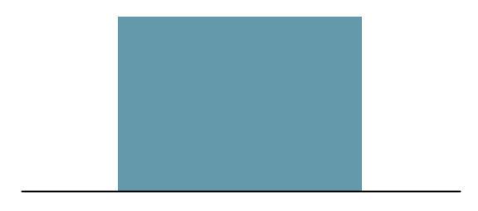
3
Counties are critical to prison reduction strategy
State funding
$2,669
County funding
Joint funding
Mandatory supervised release
Counties will bear the majority of the costs of reducing the prison population
$37,102
$2,779
Probation
Incarceration (IDOC)
$35,500
Incarceration (Jail)
Sources: State costs from IDOC for FY 2014; Jail costs from Will County’s jail expenditures divided by average daily population provided by IDOC; Probation costs from Will County’s probation expenditures divided by total active probation caseload from the annual report of the Administrative Office of the Illinois Courts.
<number> / 10

Slide 8
C
Additional questions
4
How does this fiscal and budget information support your subcommittee's work?
2. What fiscal questions must be answered to safely decrease the state’s prison population?
<number> / 10

Slide 9

C
4
The Will County Auditor, Duffy Blackburn, was instrumental in the production of this analysis.
His shared data and the contribution of his time is greatly appreciated by the team.
http://www.willcountyauditor.com/
<number> / 10

Slide 10
C
Next steps
D
4
Finalize scope and approach to Phase II
  Collect budgetary data for additional counties
  Potentially increase timeframe to 3-5 years
  Address questions
Provide ongoing updates
  Budget and Capacity subcommittee to provide ongoing updates
How will local policymakers react to the fiscal and budget impacts of the prison reduction?
What counties should we examine next?
  Data available
  Representative issues present
  Important trends
<number> / 10

Slide 11
Appendix
A
Background on analysis
B
Additional data on Will County
C
Primary and secondary data sources

Slide 12
A
Offices and agencies included in funding flow
Police
$88.7M
Jail
$40.6M
Court
$30.2M
Prison
$51.2M
Supervision
$8.5M
Municipal Police
Sheriff’s County Law Enforcement
Sheriff’s
County Jail
Juvenile detention
Circuit Court (not including probation)
Public Defender
State’s Attorney
Sheriff’s Court Security
Dept. of Corrections
Dept. of Juvenile Justice
Probation
MSR (parole)
TASC case management
Prison and MSR costs calculated with the total number of IDOC admissions from Will County, the average length of stay for Will County offenders by offense class, and the average cost of incarceration or parole per person. The average cost includes pension and benefit costs outside the IDOC budget ($37,102 per prisoner per year; $2,669 per parolee per year).
Only 80% of Circuit Court budget included because 20% of court filings are civil. Circuit Clerk costs, which serves as the filing and record-keeping functions for the court, are excluded because the percent of the workload devoted to criminal cases was unable to be determined.

Slide 13
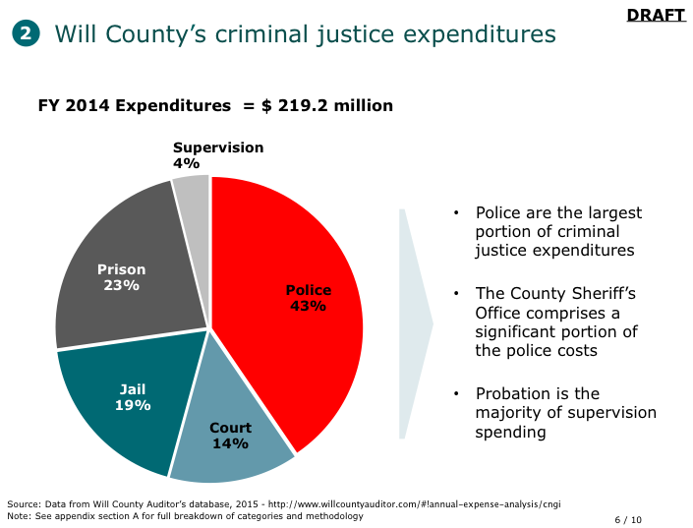
A
Will County FY 2014 expenditures by department
Police: Joliet and Bolingbrook police, Sheriff’s law enforcement, 33% of Sheriff’s administrative costs
Court: Sheriff court security, 33% of Sheriff’s administrative costs, Circuit Court, Adult Drug Court, Public Defender, State’s Attorney
Jail: Sheriff jail officers, 33% of Sheriff’s administrative costs,
Court’s juvenile detention
Prison: IDOC–prisons and IDJJ-detention facilities
Supervision: Probation department, IDOC-MSR, TASC
Sources: Data from Will County Auditor’s database, 2015 - http://www.willcountyauditor.com/#!annual-expense-analysis/cngi,
SPAC analysis of IDOC data, TASC

Slide 14
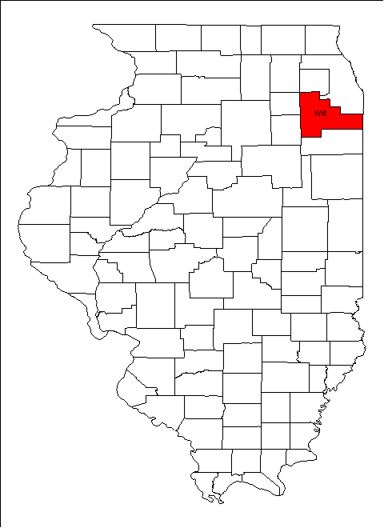
Will County overview
B
 | Will County | State of Illinois
Population | 677,560 | 12,830,632
Median Age | 35.4 | 36.6
White | 76% | 71.5%
Black | 11.2% | 14.5%
Other | 12.8% | 14%
Hispanic (any race) | 15.6% | 15.8%
Source: U.S. Census Bureau, 2010 Census.

Slide 15
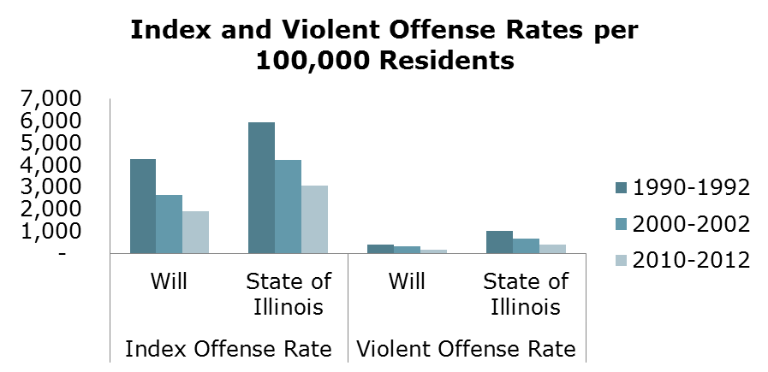
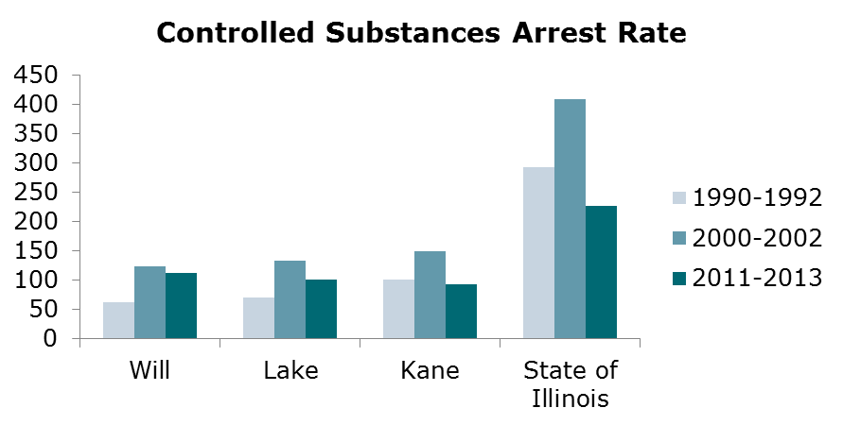
Criminal justice trends in Will County
B
Source: Analysis of Illinois Uniform Crime Report

Slide 16
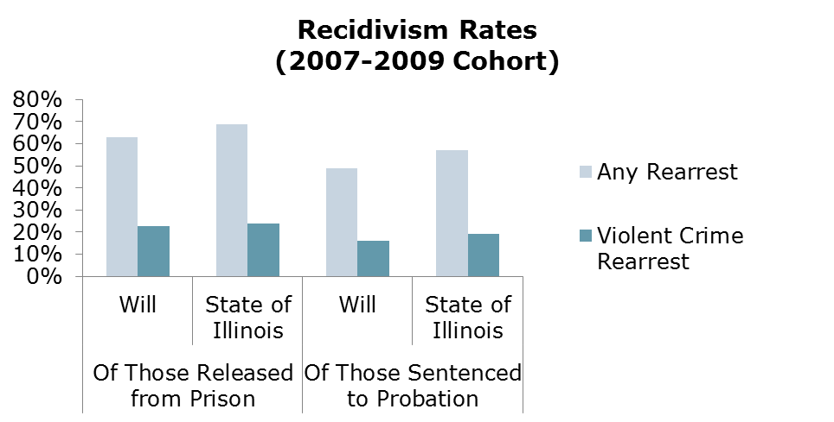
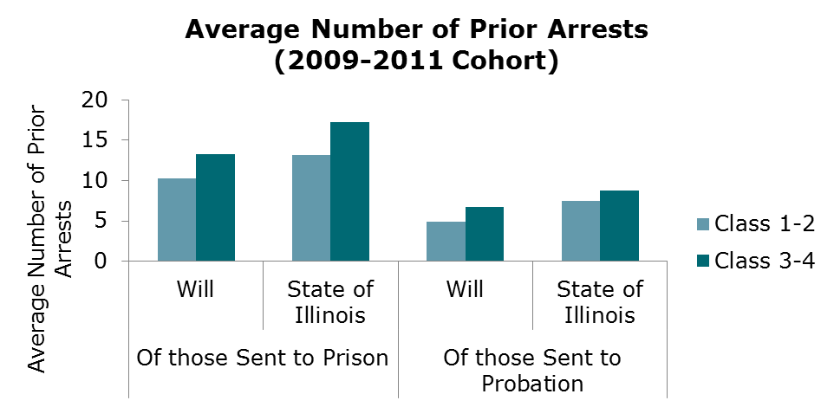
Criminal justice trends in Will County
B
Source: ICJIA web-based Criminal History Tool

Slide 17
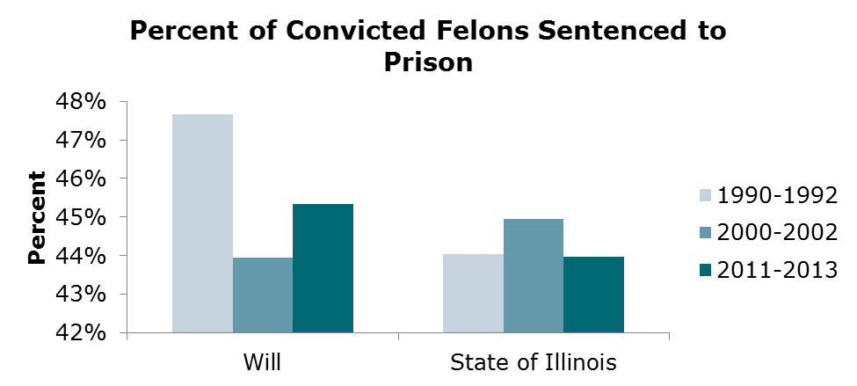
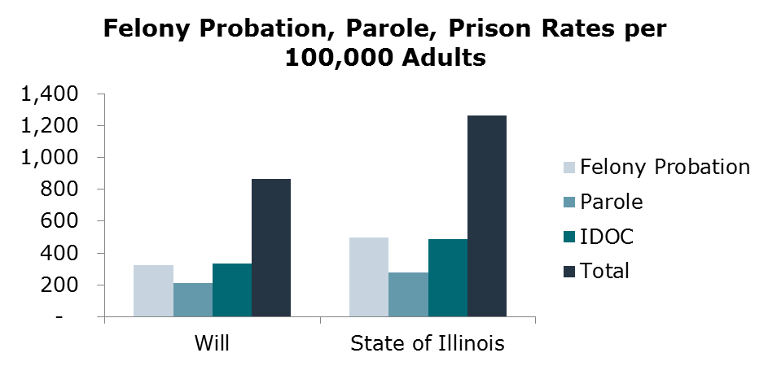
Criminal justice trends in Will County
B
Source: Analysis of Administrative Office of the Illinois Courts (AOIC) and IDOC data by David E. Olson, Ph.D.
Note – Rate based on population 17 years old and older

Slide 18
Interviews
C
Contact | Title, Organization
Duffy Blackburn | Auditor, Will County
Alexis Sturm | Director of Research and Fiscal Reporting, Illinois Office of the Comptroller
Wendy McCambridge | Associate Director, Federal and State Grants at Illinois Criminal Justice Information
Janelle Prueter | Vice President of Operations, Treatment Alternatives for Safe Communities
Mike Tardy | Director, Administrative Office of the Illinois Courts
Dave Olson | Director of Criminal Justice and Criminology Graduate Program, Loyola University Chicago
Jon Johnson | Director of Budgets, Chicago Police Department
Megan Alderden | Associate Director, Illinois Criminal Justice Information Authority
Chris Devitt-Wesley | Manager, The Data Clearinghouse and Analysis Center
Mark Powers | Research Analyst, Illinois Criminal Justice Information Authority
John Prinzi | Director of Court Services, Will County Circuit Court

Slide 19
List of resources
C
Resources
Administrative Office of the Illinois Courts, Annual Report of the Illinois Courts, Statistical Summary, 2013
Administrative Office of the Illinois Courts, Illinois Probation, Pretrial and Detention Overview, 2015
David Olson, Ph.D., analysis of Administrative Office of the Illinois Courts (AOIC) and Illinois Department of Corrections (IDOC) data
Illinois Criminal Justice Information Authority, Criminal History and Recidivism Tool
Illinois Criminal Justice Information Authority, Crime and Risk Factor Data, Detailed Tables
Illinois Uniform Crime Report
American Society of Criminology, Annual Report, 2014
U.S. Census Bureau, 2010 U.S. Census

